Slide 1
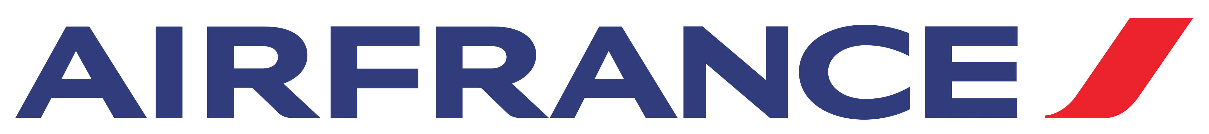
Internet Marketing:
Optimizing Google, Yahoo!, MSN, Overture and Kayak Sponsored Search
Business case presentation
Team 16 – MsBA1

Slide 2
SEM Analysis
Analysing Air France SEM strategy
Viewing publisher’s data from Global and US based
Determine how Air France can increase their market share in the US market
Notes:
Based on our analysis of each publisher as well as third party websites like Kayak
We took a look at how Air France can increase their revenue and US market share through our analysis

Slide 3
SEM Goals
1
2
3
Increase Revenue
Increase ROA
Improve SEM Strategy
Notes:
Improve SEM strategy by keeping cost/click low (3)
Increase net revenues
Decrease ad cost
Increase ROA?

Slide 4
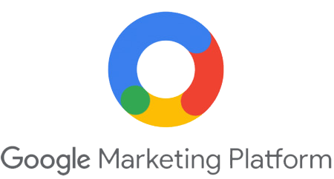

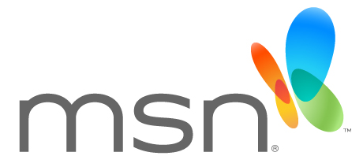
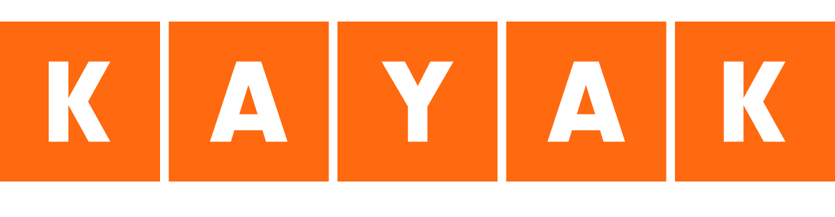
Publisher Competitors
Tailored publisher strategies could perform better for Air France
Variation in bid strategies and costs-per-click
Notes:
Q1 from case
Should Media Contacts recommend a uniform strategy for Air France across search engine publisher?
We focused on which publisher had what strategy and the revenue generated

Slide 5
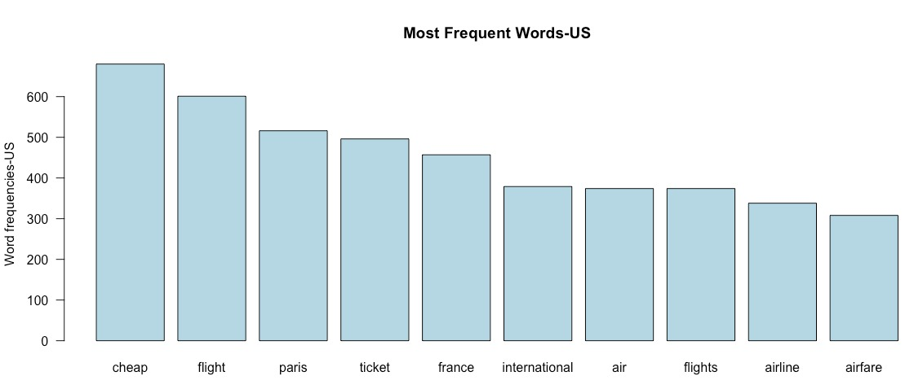
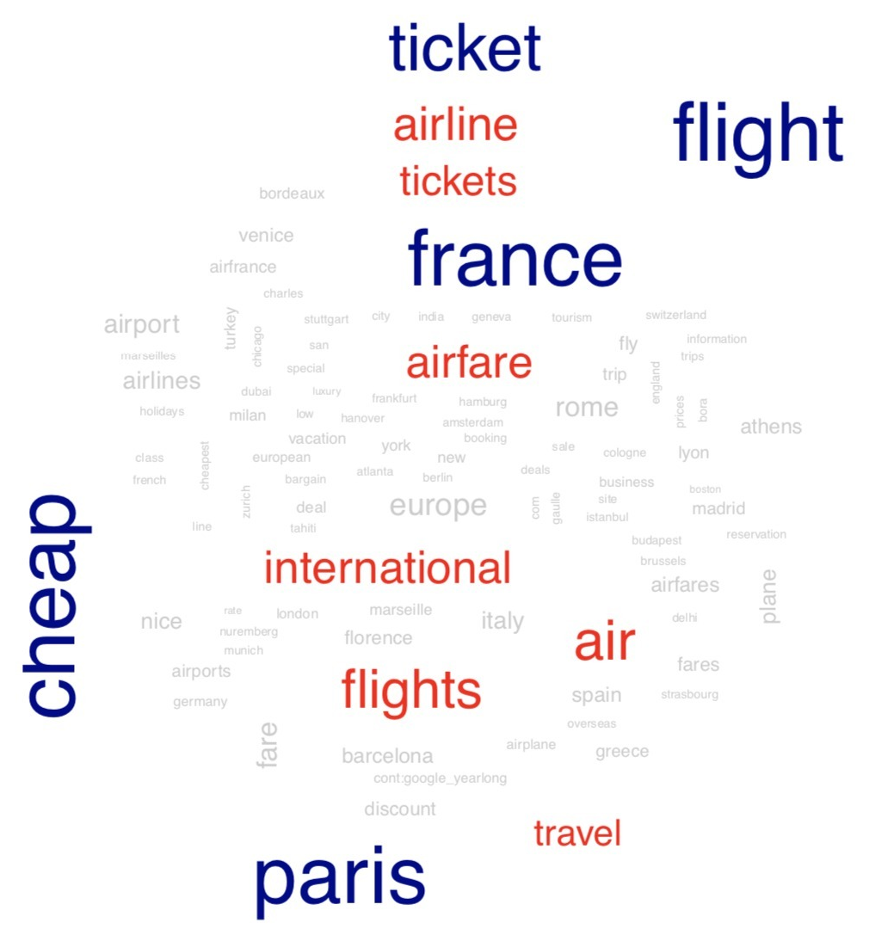
Frequent Words
Most Frequent words US
Branded keywords seem to be the most profitable
Most profitable words include destination
Geo-targeted and generic terms are not as profitable
Notes:
Word cloud is a visual of most searched for words on US & global platforms
Also, the keywords including airfrance and a destination, such as “Airfrance to paris”.
(Ex: “Cheap flight to Rome”) are not profitable geotargeted terms
Based on our analysis in the key words we want to maintain a consistent online brand image for Air France
Try to focus on unique words consistent with the brand in order to increase their digital image
Instead of focusing on high cost words, we an also try to focus on lower cost words to drive an increase in revenue
Q2 – Try to answer these questions in the narration
How can campaigns be improved to increase overall value gained from investment with a search engine publisher?
Should keywords be added or dropped from the campaign?
Should campaign tactics or copy be adjusted to improve campaign performance?

Slide 6
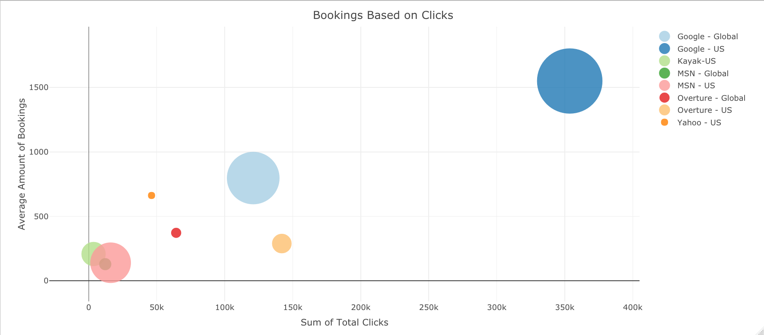
Booking Success
Bookings Based on Clicks
Publishers and their average amount of bookings in comparison to total clicks
A good indicator of SEM strategy performance
Notes:
As we can see in this fantastic bubble chart:
Google US has the highest avg amount of bookings, as well as the most total clicks
-Although this looks great, they are still the most costly publisher in comparison
Google’s SEM strategy is clearly reaching more people in order for to generate higher avg amount of bookings
Yahoos click cost is cheaper but there's still a very high amount of bookings

Slide 7
…
What are the Costs?
Comparison of Global and US publisher costs
Google is most costly
What should Air France do?
Notes:
Air France chose to spend on these publishers; however their market share didn’t reflect what they expected
Google’s total costs amounts to much higher fees that Air France has to pay
Global cpc is lower
Higher spending in US cpc but they’re not strategically spending their marketing budget

Slide 8
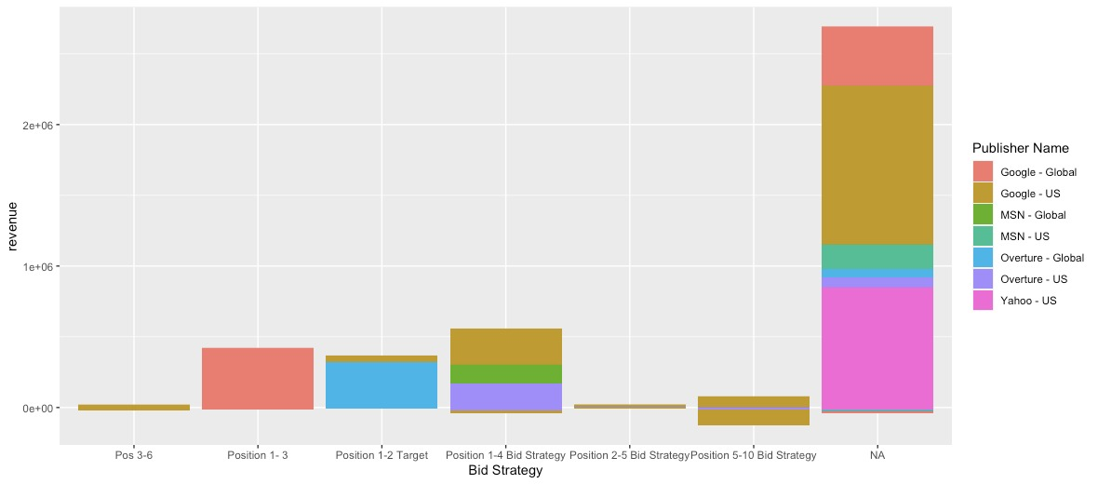
Bid Strategy per Competitor
2e+06
Revenue
1e+06
0e+00
Pos 3-6
Position 1-3
Position 1-2 Target
Position 1-4 Bid Strategy
Position 2-5 Bid Strategy
Position 5-10 Bid Strategy
NA
Bid strategy
Notes:
Along with ROA, total revenue are indicators of publisher SEM strategy success
This chart shows each publisher’s bid strategies, and highlights which generates the most revenue
Most large publishers in the US do not or have very little bid strategies
Google is able to charge more because of their diverse bid strategy, however that does not equate to more bookings
This might have an adverse effect on Air France’s online presence
The risk related to big publishers is that they spend more on their marketing budget without the benefit of increasing their revenue
Q3
What are the most important KPIs
and what impact will campaign changes have on these KPIs?

Slide 9
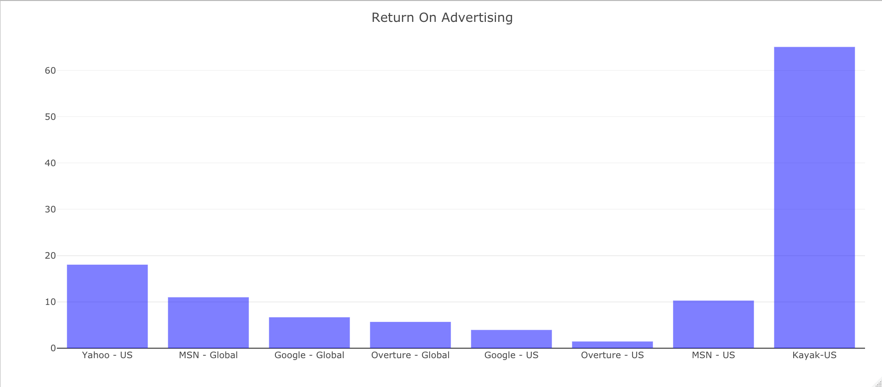
ROA Comparison
Return on Advertising
ROA highlights how much market success the campaigns are producing
Smaller search engines result in much higher ROAs
Notes:
From this bar chart, we can see the publishers ROA: Kayak has the highest ROA, because they are a lot cheaper compared to Google
Compared to the last graph; we would expect that Google’s ROA would return just as much, however they have the 2nd lowest ROA
Other US-based publishers that did not have specific bid strategies clearly show that there are higher returns from their advertising
Kayak has the highest ROA, because their website is targeted to consumers who are already looking to travel
They may not reach as many people like Google does, but their audience is targeted the offerings of the company
Q4
How should future SEM campaigns be structured?
In the past, Media Contacts had concentrated on Google, Microsoft, and Yahoo; was there now an opportunity to optimize search advertising with metasearch companies such as Kayak?
blindly choosing larger competitors is a uniform choice but AF should choose a tailored choice

Slide 10
Recommendations
Publisher | Cost per Dollar Earned ($)
Google – US | 0.25
Yahoo | 0.05
Kayak | 0.01
Increase Budget for Other Publishers
Increase Net Revenue and US market share
Notes:
Based on the previous insights, when looking at the publishers and 3rd party websites ROA, word frequencies and cost-per-click comparisons
we can see that
Air France spends 25 cents on every dollar earned in revenue with Google US compared to Yahoo and Kayak
Our recommendations are as follows:
A diverse bid strategy seen in Google doesn’t necessarily mean positive growth in market share for Air France
The budget spent on Google could be decreased, and spread out to other US publishers as well as US based 3rd party booking websites similar to Kayak
- Therefore to decrease ad costs, thus increasing their overall net revenue and increase US market share

Slide 11
Thanks!
Does anyone have any questions?
Sarah Medina
Vi Nguyen
Bogdan Gubarev
Henrik Bjønness

